Slide 1
2.2_Selenium_FromObjectToPage(homework Session6)
Requirements:
Using http://email.163.com as example
Create a Login163 Page class with necessary objects and constructor defined (refer to screenshot in Page2 for required objects)
Create a test script:
  Launch browser and go to 163 mailbox
  Create codes by using the Login163 page object to login
There are two files are required, one is the page class file, the other is the test script file, upload them into below directory once you make it successfully run: \\cnshn13db04v\Share_SDC\Webber Ling\SeleniumHomework\Session6

Slide 2
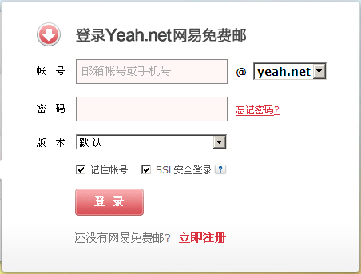
Web Page
Example: 163 Mail

